Slide 1
Predicting customer buying behaviour
Build a predictive model to understand factors that influence buying behaviour

Slide 2
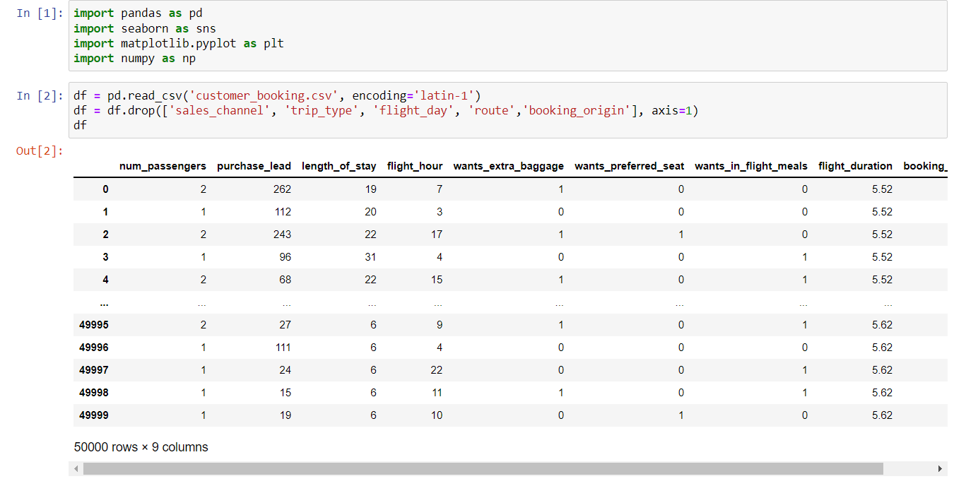
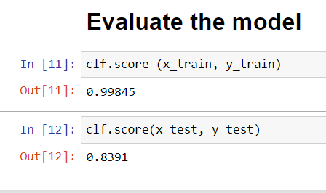
Making a model for prediction
Prediction Accuracy

